Slide 1


Uber Ride Data Analysis
Strategic Insights for NCR Region
(Jan 2024 – Dec 2024)
NXT39_ONL3_DAT1_S8

Slide 2



Analatica Team
Ahmed Osama Mohamed Mobarez
Fawzy Mohamed Ahmed Shams
Anton Samy Tawfeek
Ahmed Hessien Ahmed
Essam Mohamed Ahmed
Hassan Ashraf

Slide 3
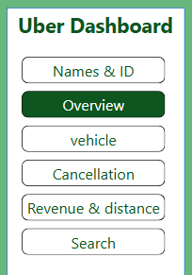
Project Objectives
Overview Dashboard: Identify monthly trends and provide insights for strategic decisions.
Vehicle Dashboard: Optimize fleet mix, improve ratings, and support growth.
Cancellation Dashboard: Reduce cancellations and enhance service quality.
Revenue & Distance Dashboard: Improve fleet operations and customer experience.
Search Feature: Provide granular details for specific trip inquiries

Slide 4
Data Profile & Methodology
Dataset Overview:
Source: Uber Ride Data – NCR Region
Volume: ~150,000 processed records
Key Metrics: Booking status, vehicle type, location, ratings, revenue
Technical Workflow:
Data Exploration: Profiling 21 features, analyzing missing values (VTAT, CTAT)
Data Cleaning:
Imputation via group means (Vehicle/Location)
Route-based distance imputation
Validation: Removing logical inconsistencies to ensure high data integrity

Slide 5
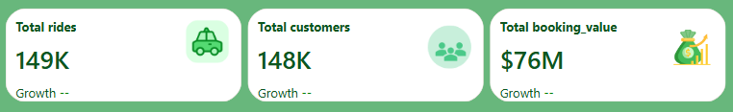
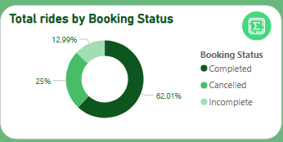
Executive Overview (KPIs)
Total Rides: 149,000
Total Customers: 148,000
Total Booking Value: $76 million
Booking Status Breakdown:
Completed: 62.01%
Cancelled: 25%
Incomplete: 12.99%
Monthly Trend Highlights:
Peak: July (12,800 rides)
Followed by: October (12,544 rides)

Slide 6
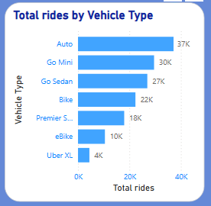
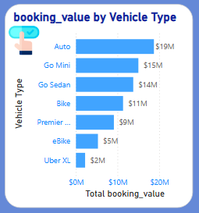
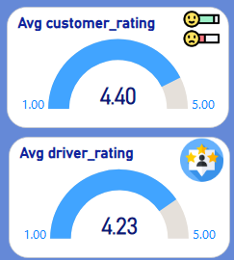
Vehicle Performance Analysis
Most Popular Vehicle: Auto (37K rides)
Highest Revenue Generator: Auto ($19M)
Customer Rating : 4.40 / 5
Driver Rating : 4.23 / 5

Slide 7
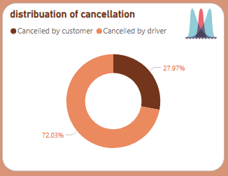
Cancellation Insights
Distribution:
Driver Cancellations: 72.03%
Customer Cancellations: 27.97%
Top Reasons:
Drivers:
Personal issues
car issues
customer-related issues
Customers:
Wrong Address (22.57%)
Change of Plans (22.35%)

Slide 8
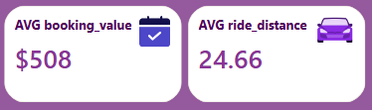
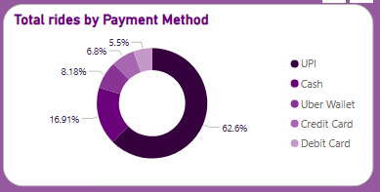
Revenue & Financial Metrics
Avg Booking Value: $508
Avg Ride Distance: 24.66 km
Payment Method Share:
UPI: 62.6%
Cash: 16.91%
Top Locations:
Akshardham and Janakpuri > $500 average values.

Slide 9
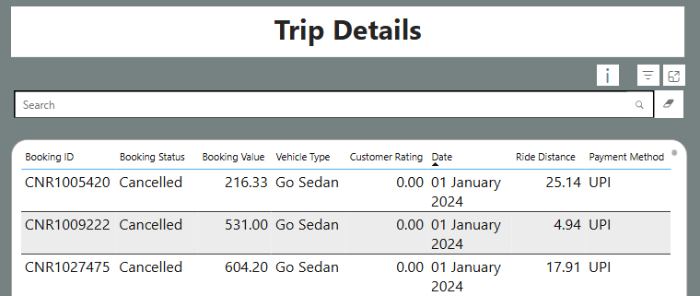
Search & Granular Tracking
Search any Booking ID
Shows: Status, Revenue, Vehicle, Customer/Driver Rating
Useful for:
Customer support
Investigating incomplete/cancelled rides

Slide 10
Strategic Recommendations
Reduce Cancellations:
Penalties for unjustified driver cancellations; improve pickup location accuracy.
Improve Wait Times:
Incentivize drivers in high-demand locations to reduce CTAT.
Fleet Optimization:
Promote Premier / Uber XL to diversify revenue beyond Auto.
Digital Payment Expansion:
Build on UPI dominance through wallet partnerships and digital incentives.

Slide 11
Summary of Findings
Service Reliability: 62% completion rate; customer rating 4.4/5
Revenue Drivers: Auto & UPI dominate revenue streams
Operational Bottlenecks:
Driver cancellations extremely high (72%)
CTAT wait time 29.15 mins , a key driver of cancellations

Slide 12
Analatica Team:
thanks, DEPI
-

